Slide 1
High School Psychology: Why is it important?
06.28.2017
Antonio E. Puente, Ph.D.
University of North Carolina Wilmington

Slide 2
Disclaimer & Conflict of Interest
Disclaimer: The information contained in this extended presentation is not intended to reflect the policy of AMA, APA, CMS (Medicare), any division of APA, NAN, NAP, NCPA (or any state psychological association), state Medicaid and/or any private third party. Further, this information is intended to be informative and does not supersede APA or state/provincial licensing boards’ ethical guidelines and/or local, state, provincial or national regulations and/or laws. Further, Local Coverage Determination and specific health care contracts supersede the information presented. The information contained herein is meant to provide practitioners, health care institutions (e.g., insurance companies)and policy makers involved in psychological services with the latest information available to the author regarding the issues addressed. This is a living document that can and will be revised as additional information becomes available. The ultimate responsibility of the validity, utility and application of the information contained herein lies with the individual and/or institution using this information and not with any supporting organization and/or the author of this presentation. Suggestions or changes should be directly addressed to the author. Note that whenever possible, references are provided. Finally, note that the CPT system is copyrighted and the information contained should be treated as such. CPT information is provided as a source of education to the readers of the materials contained.
Conflict of Interest: I am president of the American Psychological Association.

Slide 3
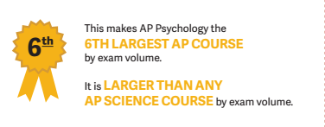
Psychology in High Schools
High school courses in the mid 20th century were typically electives and instructors lacked degrees in the field.
The APA TOPPS (Teachers of Psychology in Secondary Schools) was created in the 1990’s, promoting excellence in the study of psychology through their National Standards of High School Psychology Curricula.

Slide 4
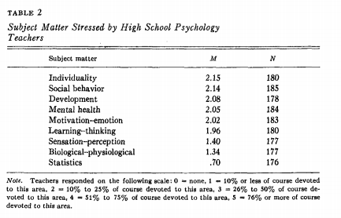
Psychology in High school

Slide 5
A Brief History of the Psychology Course in American High Schools
Prior to the arrival of experimental psychology in the US in the late 19th century, courses in “Mental philosophy” were taught which studies the topics of intellect, senses, emotions, and will.
These courses were typically required for graduation from universities however these courses were not uncommon for high school students by the 1830’s-40’s; one of the most popular textbooks was Thomas Upham's Elements of Mental Philosophy.

Slide 6
A Brief History of the Psychology Course in American High Schools
~12 books published around that same time that designate their use for high schools; another of this type is Andrew Peabody’s 1873 textbook, A manual of Moral Philosophy Designed for Colleges and High Schools or Daniel Putnam’s (1889) Elementary Psychology, or the First Principles of Mental and Moral Science for High, Normal, and Other Secondary Schools and for Private Reading
Late in the 19th century and early in the 20th century Psychology as a high school course was valued for its moral training; later in the 20th century psychology was valued for its pedagogical value.

Slide 7
A Brief History of the Psychology Course in American High Schools
APA’s first involvement in high school psychology was in 1935 with the creation of the Committee to Study the Problems Connected with the teaching of Psychology in High Schools and Junior Colleges. Part of the committee was Goodwin Watson and Calvin Stone;
As early as 1962, high school teachers were allowed as affiliates to the APA; they were even invited to secondary school specific workshops
Notes:
they investigated the study of psychology in high school and concluded that the current text books were inappropriate because they included too much information of the “psychological sciences” and too little with the “life problems of adolescents”. The following year, their research concluded that 12% of schools surveyed had a psychology course currently and 37% that did not have one said that one should be added to the curriculum. (Paterson,1935)

Slide 8
A Brief History of the Psychology Course in American High Schools
In 1970, APA created the Clearinghouse for Precollege Psychology under the APA Office for Educational Affairs. Notably, the Clearinghouse started the publication first entitled Periodically in Sept. 1970. It was mailed to 5,600 high school psychology teachers and included information and publications appropriate for a high school setting. It has changed named to The Psychology Teacher Network and is still published quarterly. (Kasschau, 1974)
In 1988, the College Board approved psychology as an AP course after 18 years of failed proposals by the APA. The first AP psychology exam was administered in May of 1992, in the centennial year of the APA.

Slide 9
Why is high school psychology important?
High school psychology courses are frequently students' first — and maybe only — exposure to psychology

Slide 10
Why is high school psychology important?
High school psychology courses are frequently students' first — and maybe only — exposure to psychology
High school psychology teachers play an important role in educating the public about psychology

Slide 11
Why is high school psychology important?
High school psychology courses are frequently students' first — and maybe only — exposure to psychology
High school psychology teachers play an important role in educating the public about psychology
High school psychology teachers promote scientific and psychological literacy

Slide 12
Why is high school psychology important?
High school psychology courses are frequently students' first — and maybe only — exposure to psychology
High school psychology teachers play an important role in educating the public about psychology
High school psychology teachers promote scientific and psychological literacy
High school psychology teachers foster students’ wellbeing and college and career preparedness

Slide 13
Why is high school psychology important?
High school psychology courses are frequently students' first — and maybe only — exposure to psychology
High school psychology teachers play an important role in educating the public about psychology
High school psychology teachers promote scientific and psychological literacy
High school psychology teachers foster students’ wellbeing and college and career preparedness
Enrollment in high school psychology courses continues to rise annually

Slide 14
Why is high school psychology important?
High school psychology courses are frequently students' first — and maybe only — exposure to psychology
High school psychology teachers play an important role in educating the public about psychology
High school psychology teachers promote scientific and psychological literacy
High school psychology teachers foster students’ wellbeing and college and career preparedness
Enrollment in high school psychology courses continues to rise annually
The pipeline of psychology majors and psychologists begins here

Slide 15
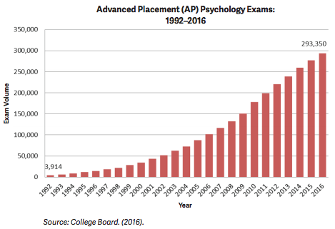
Why is high school psychology important?
Over 293,000 students took the AP psychology exam in 2016
30% of graduating students in 2009 earned credits in a psychology course during high school
Nearly 1 million students
AP Psychology is the 6th largest AP Course
Larger than any AP science course by exam volume

Slide 16
AP: Do minorities have equal opportunity
Minority students enroll in AP courses at approximately half the rate of white students
AP incentive programs have the potential to increase participation among minority students
Change in policy
Creating smaller “schools-within-a-school” while maintain flexibility across academic tracks
Eliminating magnet programs
Hiring qualified AP teachers
Implementing incentive programs for teachers and students

Slide 17
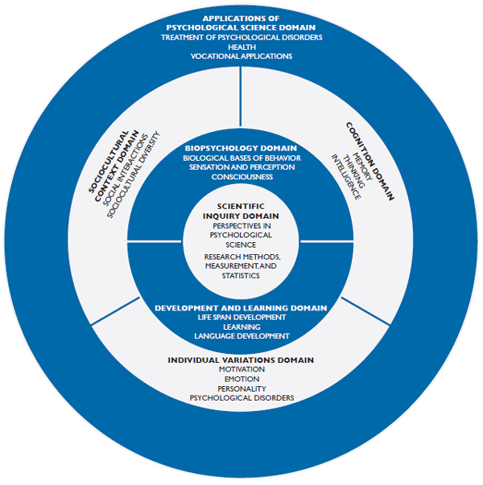
High School Psychology Curricula
Goal of the National Standards for High School Psychology Curricula
help teachers and others develop a better Intro to psychology
Students should understand: how psychologists try to understand the world, make new discoveries, and apply psychological knowledge to solve problems.
Notes:
Important considerations:
Infusing diversity
Representing the global nature of psychology
Using active learning
Using multiple resources
Develop and revise the standards

Slide 18
Why Should you take Psychology?
Not an easy A
What you learn in Psychology, you will use everyday:
Communication
Understanding a persons action
Relaxation
Etc.

Slide 19
Preparation of high school psychology teachers by colleges
Abrams and Stanley (1967) sent a questionnaire to 1,050 colleges regarding preparedness for secondary education majors who wished to teach psychology.

Slide 20
Preparation of high school psychology teachers by colleges
Abrams and Stanley (1967) sent a questionnaire to 1,050 colleges regarding preparedness for secondary education majors who wished to teach psychology.
In their concusions they call for a "take off" of psychology and compare the current (1967) state to be that of an "underdeveloped body needing resources to bring about development..."

Slide 21
Preparation of high school psychology teachers by colleges
Abrams and Stanley (1967) sent a questionnaire to 1,050 colleges regarding preparedness for secondary education majors who wished to teach psychology.
In their concusions they call for a "take off" of psychology and compare the current (1967) state to be that of an "underdeveloped body needing resources to bring about development..."
They also called for the APA to work with "outstanding high school psychology teachers, sympathetic college departments of psychology , and the College Entrance Examination Board to in setting up an Advanced Placement Program (APP) for high school students to earn college credit.

Slide 23
References
Benjamin, L. T., Jr. (2001). A brief history of the psychology course in American high schools. American Psychologist, 56,949-960.
Kasschau, R. A., & Wertheimer, M. (1974). Teaching psychology in secondary schools. Washington, DC: American Psychological
Association.
Paterson, D. G. (1935). Proceedings of the Forty-Fourth Annual Meeting of the American Psychological Association, Incorporated, Ann
Arbor, Michigan, September 4, 5, 6, 7, 1935. Psychological Bulletin, 32, 637-751.
Peabody, A. P. (1873). A manual of moral philosophy designed for colleges and high schools. New York: American Book.
Putnam, D. (1889). Elementary psychology, or the first principles of mental and moral science for high, normal, and other secondary
schools and for private reading New York: American Book.
Thompson, Trina, and James O. Rust. "Follow-up of advanced placement students in college." College Student Journal, vol. 41, no. 2, 2007, p. 416+. Academic OneFile, Accessed 27 June 2017.
Upham, T. C. (1831). Elements of Mental philosophy. Boston: Wells & Lily. Weaver, K. A. (2014). Credentialing high school psychology teachers. American Psychologist, 69(6).
White, K. M., Marcuella, H., & Oresick, R. (1979). Psychology in the high schools. Teaching of Psychology, 6, 39–42
Loesch, H. (2013, December 10). Why Everybody Should Take Psychology in High School. Retrieved June 27, 2017, from http://www.huffingtonpost.com/hannah-loesch/ap-psychology-class_b_4418571.html
Breland, N. S. (1978). A survey of precollege psychology in New Jersey. American Psychologist, 33(10), 959-961. doi:10.1037/0003-066X.33.10.959
Preparation of high school psychology teachers by colleges. Abrams, Alan M.; Stanley, Julian C. American Psychologist, Vol 22(2), Feb 1967, 166-169. http://dx.doi.org/10.1037/h0024464

Slide 24
Puente Contact Information
Websites
Coding = www.psychologycoding.com
University = www.uncw.edu/people/puente
Practice = www.clinicalneuropsychology.us
Vita/Academic = www.antonioepuente.com
E-mail
University = puente@uncw.edu
Practice = clinicalneuropsychology@gmail.com
Telephone
University = 910.962.3812
Practice = 910.509.9371

