Slide 1
The Cultural in Cross Cultural Neuropsychology
Antonio E. Puente
University of North Carolina Wilmington
Moscow International Congress
110th Anniversary of Alexander Romanovich Luria’s Birthday
11.30.12

Slide 2
Acknowledgements
Spain
Universidad de Granada; Miguel Perez Garcia, Raquel Vilar Lopez, Ahmed Fasfous (and their laboratory)
United States
UCLA; Xavier Cagigas (CNI)
John Hopkins; Anna Agranovich
UNCW; Margie Hernandez, Tara Vernazi, Davor Zink (Gershom Lazarus)

Slide 3
Thank You
Janna Glozman and the Department of Psychology at Moscow State University
Zara Millekan (MSU)
Joseph Tonkongony

Slide 4
Defining Culture
Traditional Definitions
Functional Interpretation
Unwritten rules and information that the society in which an individual lives is considered to be important for the stability and forward momentum of its goals, as interpreted (and enforced) by those in positions of significance and power

Slide 5
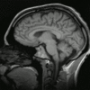
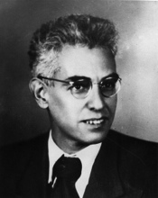
Defining Cultural Neuropsychology
The measurement of cognitive (and less so, emotional) domains mediated largely by the cerebral cortex
The domains, the interpretations of such domains, and their eventual measurement are defined by those appointed/selected by society and placed in positions of significance or power

Slide 6
Defining Power in North American Clinical Neuropsychology
Doctorate Degree from an American Psychological Association (APA) accredited program
Clinical Training (pre and post-doctoral) by an APA accredited program
Board Certification (ABCN and/or ABN)
Historically- Male, White, Northeastern US and Academic Medical Institution

Slide 7
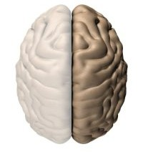
Defining Lack of Power in North American Neuropsychology
Clinical
Female
Economic, Linguistic and Cultural Minorities

Slide 8
Outcome
Restricted, Biased and Non-Generalizable Interpretations of What and How Cognitive (and Emotional) Domains Are Measured
Cognitive Over Emotional
Roger W. Sperry’s Work
Camara, Nathan & Puente, 2000; Puente & Lazarus (unpublished)
Timed Completion Vs. Appreciation of Process
Just do it (Nike)
Done is better than perfect (Facebook)

Slide 9
Cultural Assumptions: The Case for Spanish Speakers
Within Cultural Groups are Similar
Hispanic Demographics
Total Number of Subgroups Exceeds 12
Regions:
Spain
Mexico
Central America
Caribbean
South America

Slide 10
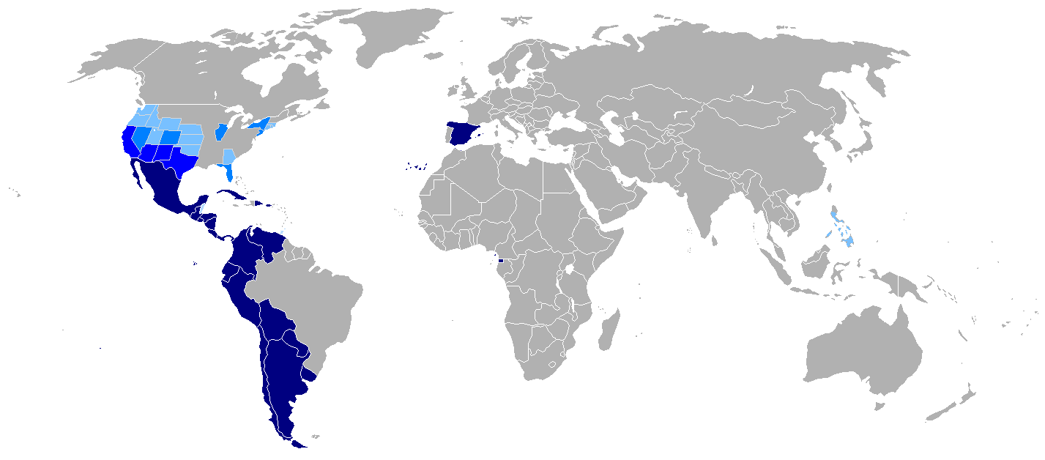
Homogeneous Vs. Heterogeneous group ?
Notes:
Homogenous:
low socioeconomic status, limited/poor education, poor health care, unskilled jobs, origin from developing or foreign countries, discrimination, English as a second language, acculturation
Heterogeneous: Depending on the country of origin idiosyncrasies include dialects, accents, vocabulary, communication styles, music, holidays, religious traditions

Slide 11
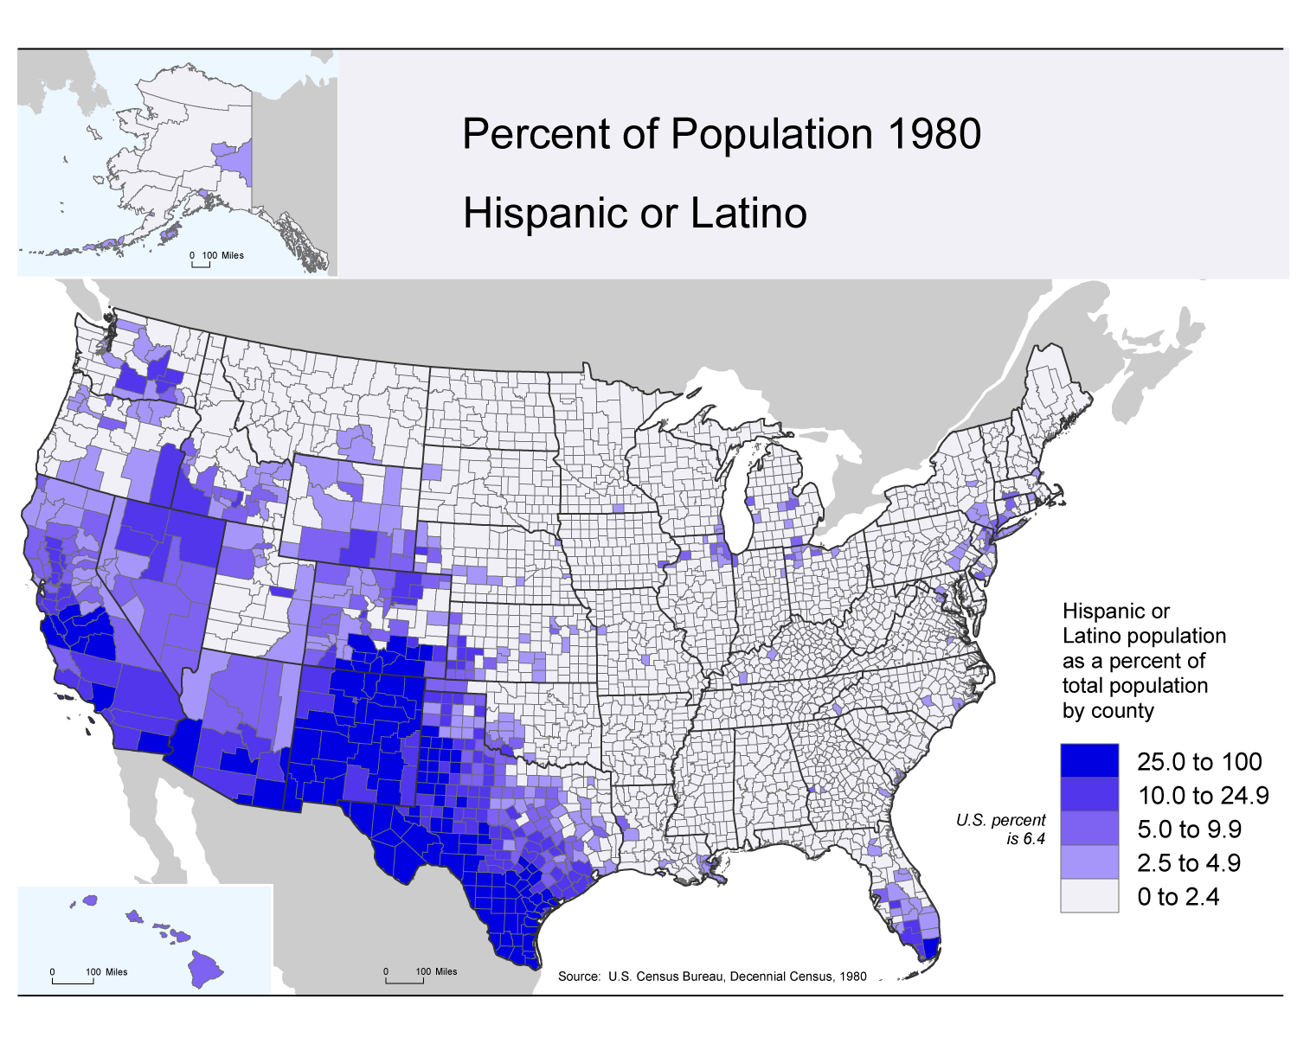
11
Notes:
6%
11

Slide 12
12
Notes:
9%
12

Slide 13
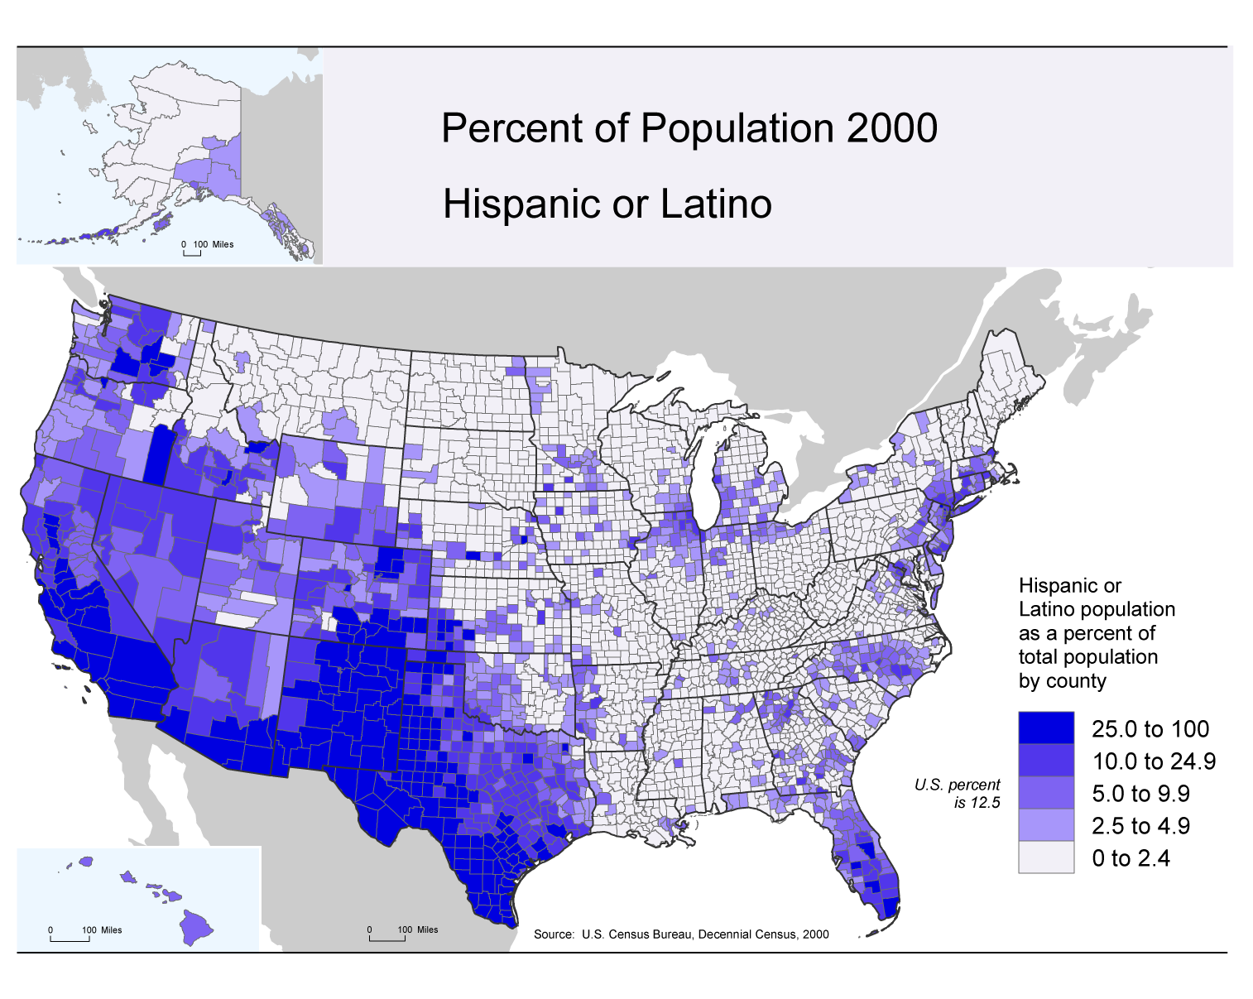
13
Notes:
12.5%
13

Slide 14
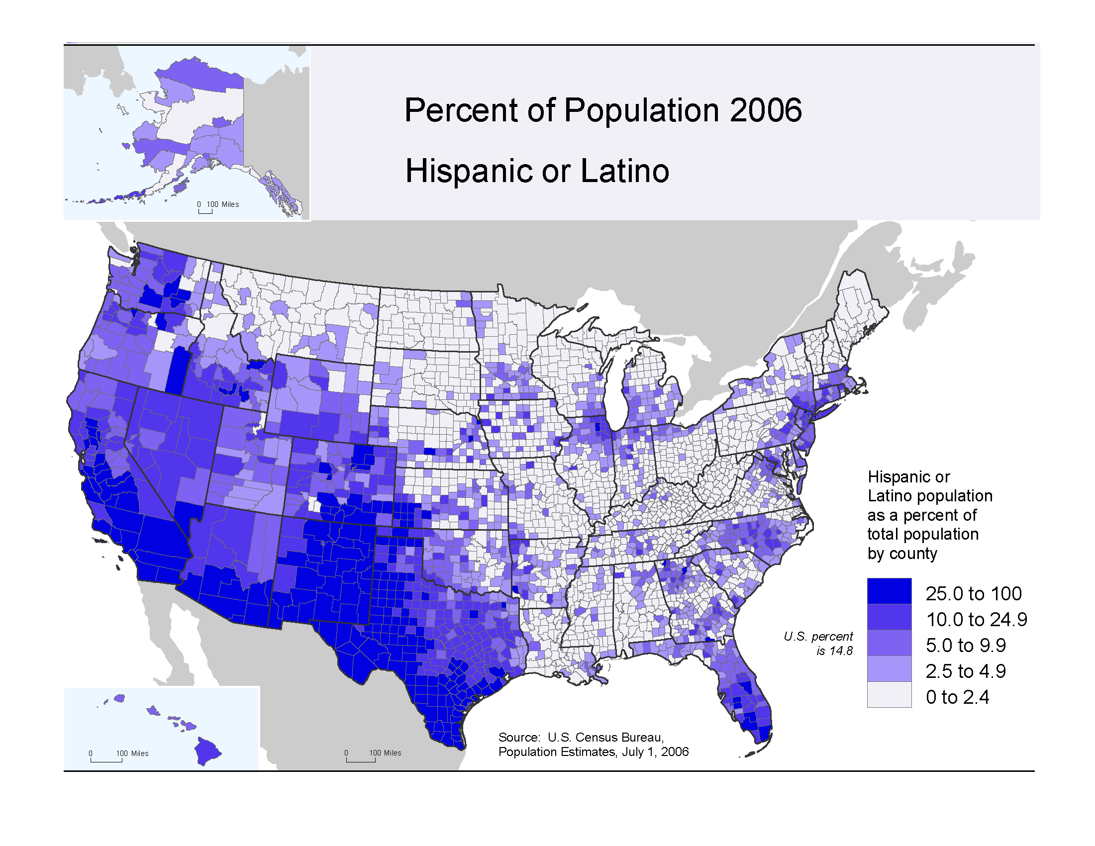
14
Notes:
14

Slide 15
Percent Hispanic of the Total Population in the United States: 1970 to 2050
Census
Projections
*Projected Population as of July 1
Source: U.S. Census Bureau, 1970, 1980, 1990, and 2000 Decennial Censuses; Population Projections, July 1, 2010 to July 1, 2050
Notes:
As you can see, currently the Hispanic population makes up 16% of U.S population...however by 2050 , about 24% of the U.S population will be made up of
Hispanics .

Slide 16
Percentages of Hispanics in the U.S.
Source: US Census, 2008

Slide 17
Two Projects
Development of the Wechsler Intelligence Scale for Children (WISC)
Comparison of Spanish Versions of the Wechsler Intelligence Scale for Adults (WAIS)

Slide 18
David Wechsler Scales
Most widely-used intelligence test in North American
High validity and reliability
User friendly administration and scoring guidelines
Excellent psychometric properties
WAIS-IV (2008)
Most current version
WAIS-III for Spanish Speakers (1997)
Mexico (2003)
Puerto Rico (2008)
Spain (2001)
Notes:
First developed in 1939..... And since has gone through five revisions

Slide 19
WAIS-III: English Version
Age: 16-89
Time: 60-90 minutes
14 subtests
7 verbal
7 performance
4 Indexes
3 IQ’s
Mainly used for determining intellectual ability and/or mental retardation
Notes:
Mainly used for determining intellectual ability and/or mental retardation

Slide 20
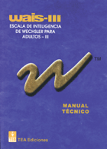
Literature on the Spanish Versions of the WAIS-III
Limited
A total of 7 articles
4: Mexican version
3: Spaniard version
Literature Review Results
Overestimated IQ’s
Large confidence intervals
Technical problems
Non-representative sample
Notes:
Limited – when you search key words Spanish and WAIS – you obtain a search of 41 articles

Slide 21
Method
Purpose- Are the three versions of Spanish WAIS equal to each other and the English WAIS?
Phase I
Qualitative analyses
Phase II
Quantitative analyses
Phase III
3x2 factorial repeated measures design

Slide 22
Phase I: Qualitative Analysis
Instruments
Four Versions of the WAIS-III
Procedure
Teaching items
Item number
Item content
Range of scores
Subtest Scale scores
4 Indexes
IQs
Confidence intervals
4 Indexes
3 IQs

Slide 23
Phase II: Quantitative Analysis
Instruments
Four versions of the WAIS-III
Subjects/Data
Ages: 18-64
De-identified raw scores for the 13 subtests
Archived Data
United States, Mexico, Puerto Rico, Spain
N= 192 profiles
12 English
12 Mexico
12 Puerto Rico
12 Spain
Notes:
(using estimates of medium effect size at .05 significance level from Cohen 1992)

Slide 24
Phase III: Comparison of Subtests
Administer Most Similar and Most Disimilar Subtest to a New Sample of Volunteers
Mexico
Spain
Chile
Subtest
Appears most dissimilar-Information
Appears most similar- Block Design

Slide 25
English Version
Mexican Version
Spaniard Version
Puerto Rican Version
1 profile = 4 profiles
12 profiles = 48 profiles
Therefore.....
12 profiles from each version will yield 192 profiles

Slide 26
Initial Results of Wechsler Studies
Superficially
Similar
Empirically
Qualitative
Quantitative
Bures, Vilar-Lopez, Portillo, Puente, et al (submitted)
Common Left/Right Hemisphere Measures
Chile, Mexico, Puerto Rico & Spain
Not Similar

Slide 27
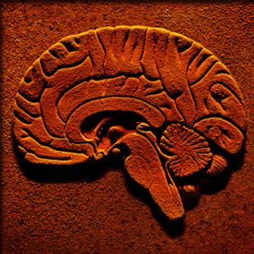
Brain Impairment & Education
Ardila, Rosselli & Puente (1994)
Neuropsychological Evaluation of the Spanish Speaker
Columbian norms
Well educated and brain impaired individuals showed similar neuropsychological performance as non-brain impaired but illiterate individuals

Slide 28
Fairness
Standards for Educational and Psychological Tests
1999
In press
Fairness Defined
Reducing construct irrelevance
Fairness as applied validity

Slide 29
Achieving Fairness in Neuropsychology
Re-defining Culture
Cultural Vs. Global Domains
Re-defining Cultural Neuropsychology
Will Neuropsychology Become Geographic, Economic and Power Based?

Slide 30
Potential Solution(s)
Applying the Concept of Fairness, Applied Validity and the Reduction of Construct Irrelevance Variance
Consider Three Separate Questions;

Slide 31
Consider Three Separate Questions
1. What is the performance of the individual compared to a culturally based domain and reference sample?

Slide 32
Consider Three Separate Questions
1. What is the performance of the individual compared to a culturally based domain and reference sample?
2. Can equating neuropsychological performance with more global concepts such as intelligence be avoided?

Slide 33
Consider Three Separate Questions
1. What is the performance of the individual compared to a culturally based domain and reference sample?
2. Can equating neuropsychological performance with more global concepts such as intelligence be avoided?
3. Can clinical neuropsychology be more than scientific, more than “romantic”; furthermore, could it become an agent of social activism?

Slide 34
Conclusion
Is there a neuropsychological “g” (as in Cattell)?
Our goal should be what can neuropsychology can do for our culture and not what culture do for neuropsychology…

Slide 35
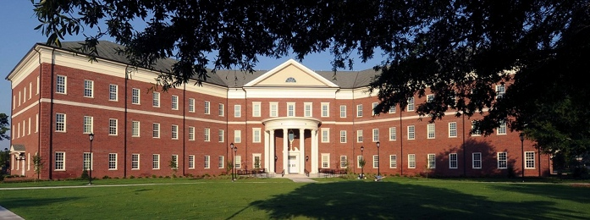
Gracias!
Antonio E. Puente, Ph.D.
Department of Psychology
University of North Carolina Wilmington
Wilmington, North Carolina 28403 USA
puente@uncw.edu

